Slide 1
STATE TRANSITION NETWORK
Bibin Varghese

Slide 2
State Transition Network
Provides a description of what actions/events are available at what point and the state the system will be in after each action.

Slide 3
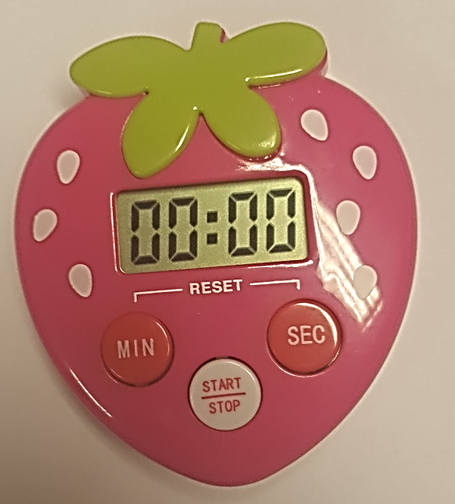
Example 1
3 Button Timer
Min
Sec
Stop/Start
Process
Pressing the min or sec increments the appropriate section of the display
Pressing the min and sec together resets the timer
Pressing the stop/start
  When the display is 00:00 starts a count up (display updates each second)
  When the display is not 00:00 starts a count down (updates each second)
    When stop/start pressed, count-down suspended
    When the time == 0 alarm sounds
      When stop/start pressed
        Alarm stops
        Time reset to starting value
        If min or sec is pressed, starting value is incremented

Slide 4
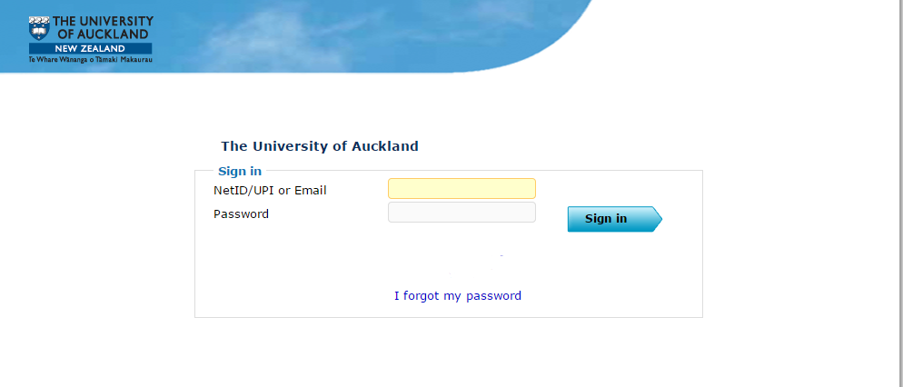
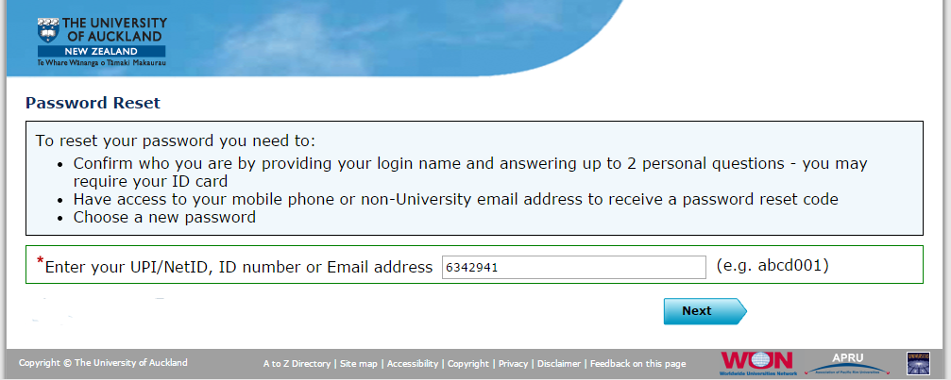
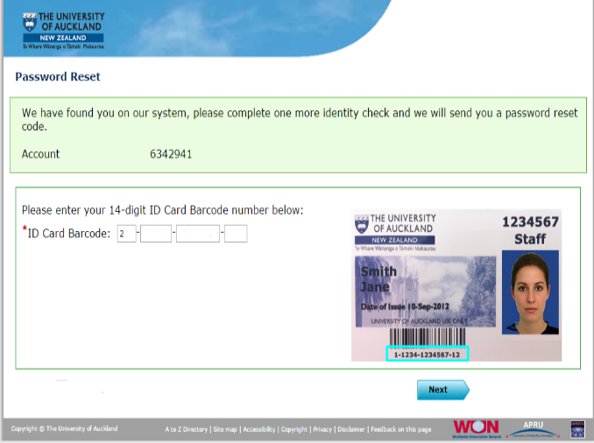
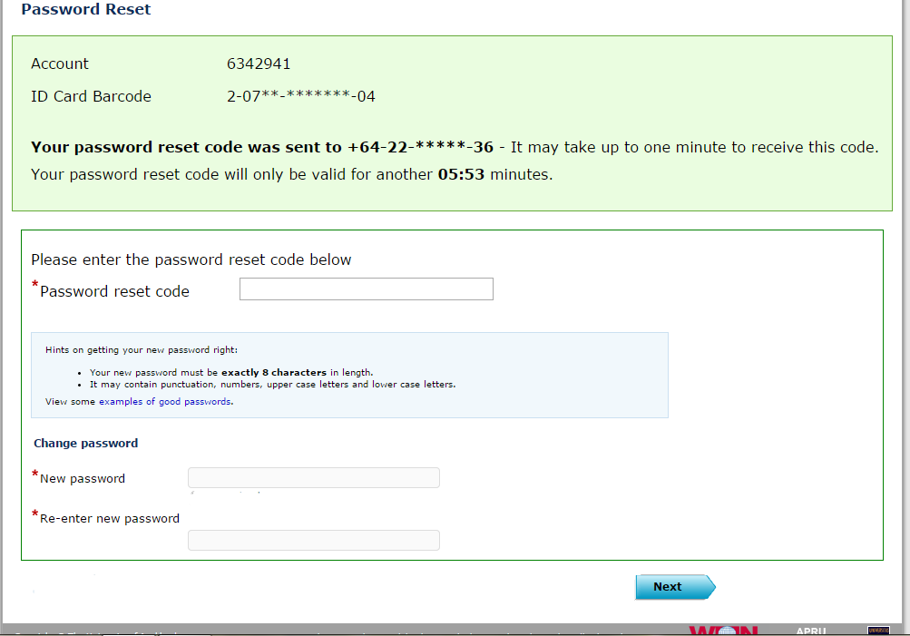
Example 2- Login of student email
Link: https://iam.auckland.ac.nz/Authn/UserPassword
If the credentials are valid, the user will be able to access the account
But if the user forgets the password he/she can click “I forgot the password” which will lead to the following chain of events( Ignore other options on the page like ‘Sign up for the account’ and ‘I cannot log in’
  User is asked to enter upi or id number or email address.(Ignore ‘Contact Support’) On clicking next,
  User is asked to enter barcode on his/her id card.
  On clicking next, a text message will be send to user, which contains the password reset code. User has to enter the password reset code received, new password and confirm new password by re-entering it.
  On clicking next, it goes to login page for new login.

Slide 5
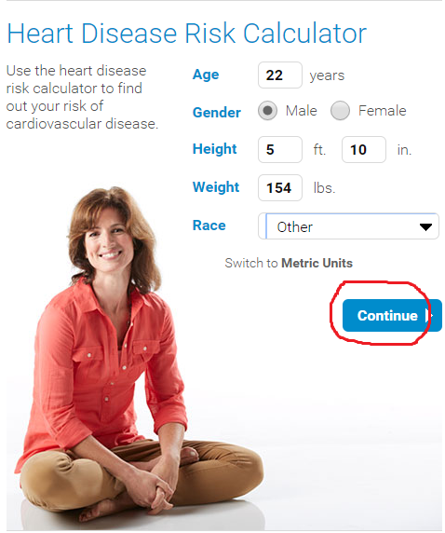
Example 3- Heart Disease Risk Calculator
Online tool to calculate heart disease risk
http://www.mayoclinic.org/heart-disease-risk/itt-20084942
Risk of cardiovascular disease is calculated based on the details provided by the user. Try out all possible options to create a state transition network diagram.

